Slide 1
Concept for the cryo distribution for the Wendelstein 7-X cryo vacuum pumps
Presented by Michael Nagel
M. Ihrke, M. Pietsch, H.-S. Bosch, C.P. Dhard and Th. Rummel
Max-Planck-Institut für Plasmaphysik Wendelsteinstraße 1, 17491 Greifswald, Germany

Slide 2
0. Contents
Introduction
(W7-X cryostat, cryo plant)
Layout of the cryo distribution
(transfer lines, valve box, cryo pump)
Functional requirements
Results (pressure drop, temperature rise)
Summary
Notes:
My talk is structured as follows:
First, I give a short overview of the W7-X cryostat and the cryo plant used for the cooling of the magnets.
Then I show our concept for the cryo distribution consisting of transfer lines, a valve box and the cryo pumps.
I,ll give details on the functional requirements of the distribution system.
Then I’ll present the calculation results for pressure drop and temperature rise for the helium and nitrogen circuits.
A short summary will close my talk.

Slide 3
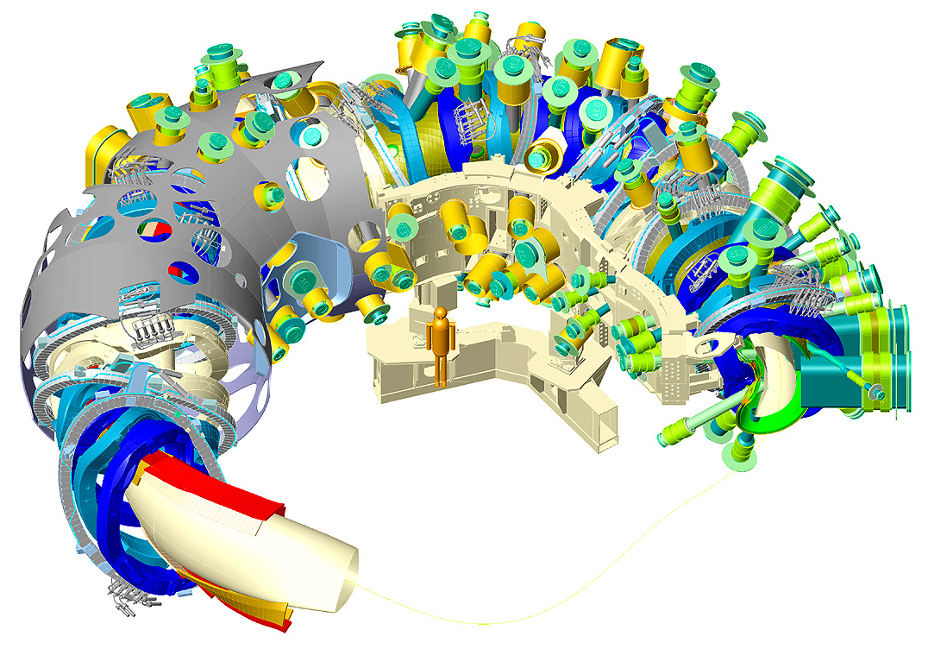
1. Introduction
20 planar coils nominal current of 16 kA at 4 K
50 non-planar coils nominal current 17.6 kA at 4 K
7 electrical circuits 5 non-planar coil circuits 2 planar coil circuits
with 10 coils each in serial
Machine base
Characteristic values
magnetic field energy: 620 MJ
magnetic peak field: 6.7 T
(on plasma axis 3 T)
Plasma vessel
Coil support structure
Plasma
Notes:
The W7-X cryostat has roughly the shape of a donut.
In the core of the outer ring is the hot plasma. It is located inside the vacuum vessel also called plasma vessel.
70 superconducting coils are stringed over the plasma vessel. The coils create the magnetic cage that keeps the hot plasma in position.
The coils are mechanically fixed at massive support structure located inboard.
The complete magnet system is inside an evacuated cryostat to minimize the heat loads on the coils.
The 70 coils are electrically connected in 7 circuits, 5 circuits for the non planar 2 circuits for the planar coils. So 10 coils are connected in serial.
The magnetic field energy is 620 MJ. The magnetic peak field at the conductor is 6.7 T. The field on the plasma axis is 3 T.

Slide 4
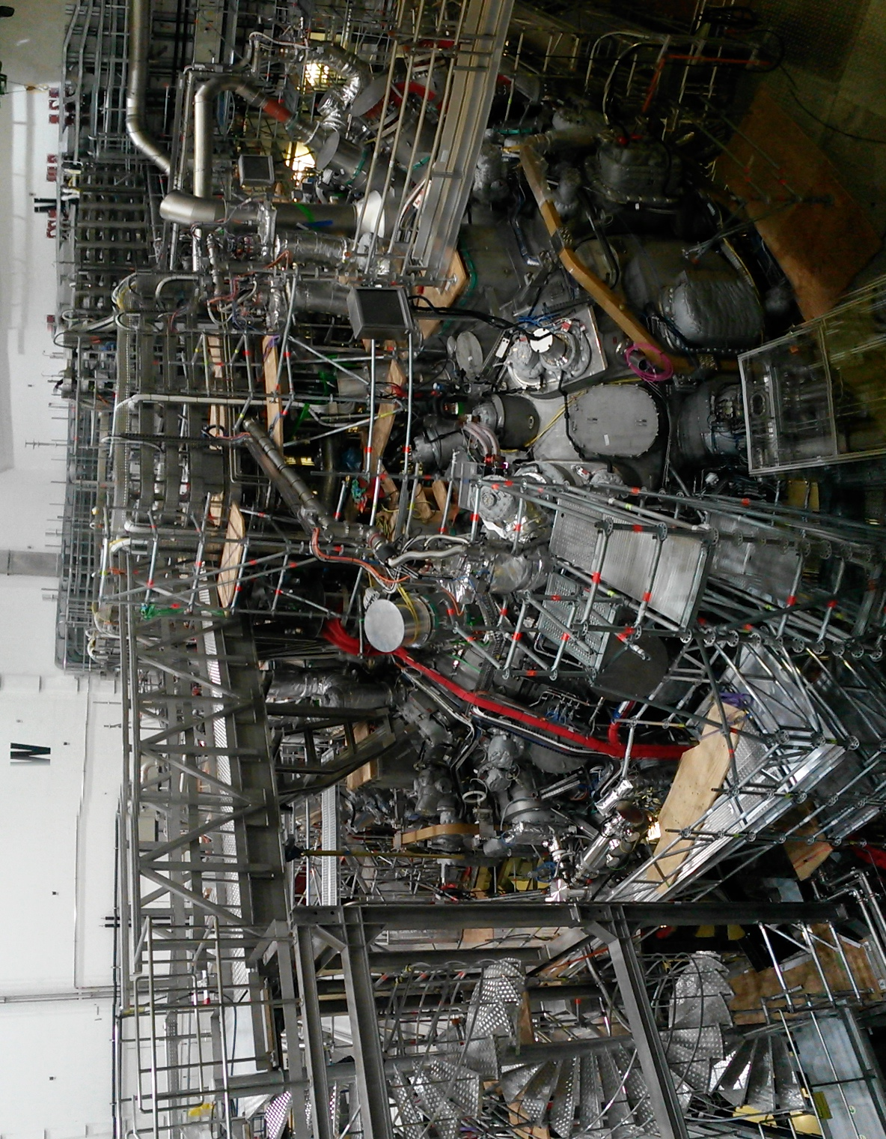
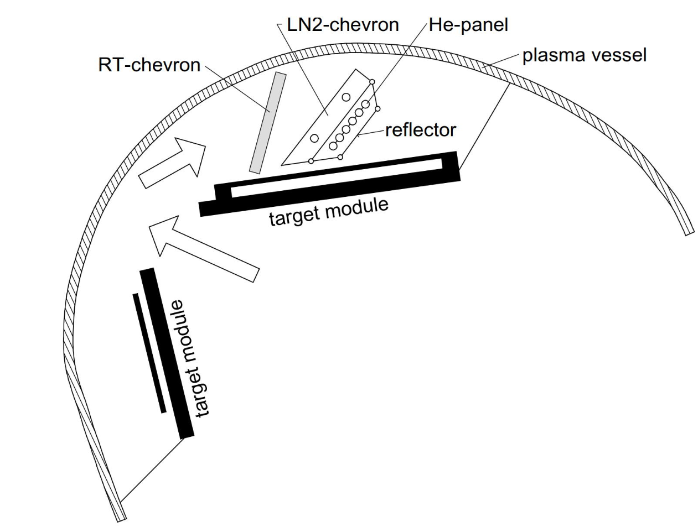
1. Introduction
View on W7-X cryostat
Experimental campaigns in 2016, 2017, 2018
Further completion with
10 actively cooled divertors
10 cryo vacuum pumps
to be installed inside the plasma vessel
Cross section of plasma vessel with target module of the divertor and cryo pump.
Notes:
Slide 3 shows a view on the W7-X cryostat inside the Torus hall.
Ports and supply systems mainly occupy the surface of the cryostat. A staircase makes the access to the center of the cryostat possible.
We had 2 experimental campaigns in 2016, 17. After the campaign in 2018, which will end in October W7-X will be further completed.
10 actively cooled divertors will be installed.
The divertors will be mounted inside the plasma vessel at the PV-wall and protect the areas with higher heat loads.
The cryo vacuum pumps sit behind the target modules, which are part of the divertor.
Particles that are pumped have to pass the pumping gap, then the RT-chevron and finally the N2 chevron bevor they are frozen on the He-panels.
The chevrons are used to reduce the thermal radiation and the micro wave stray radiation on the He-panels.

Slide 5
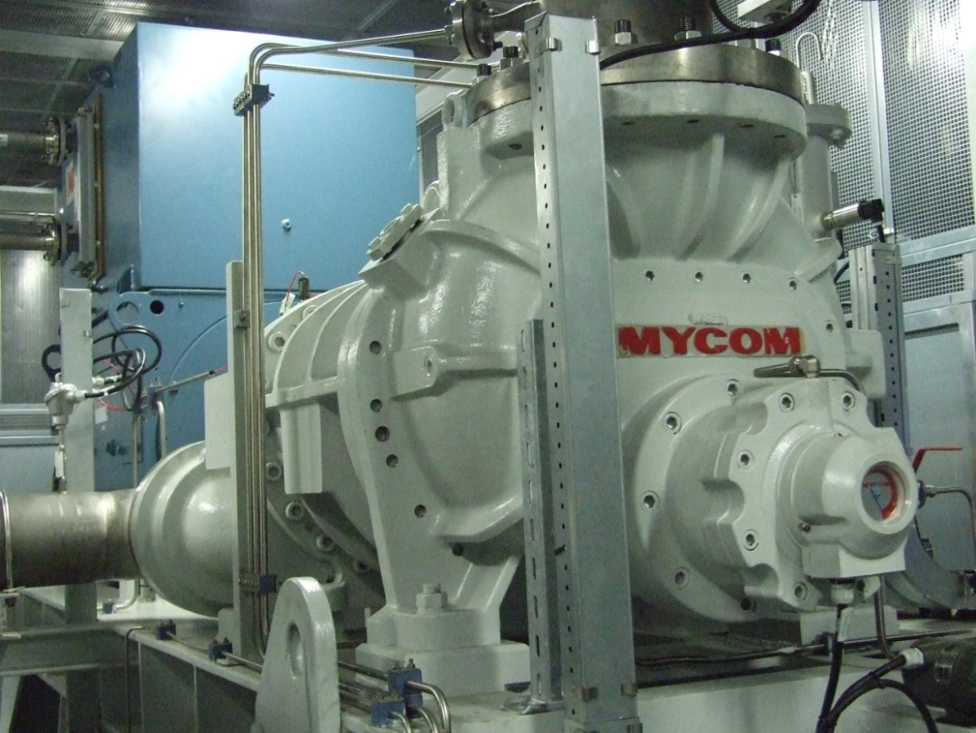
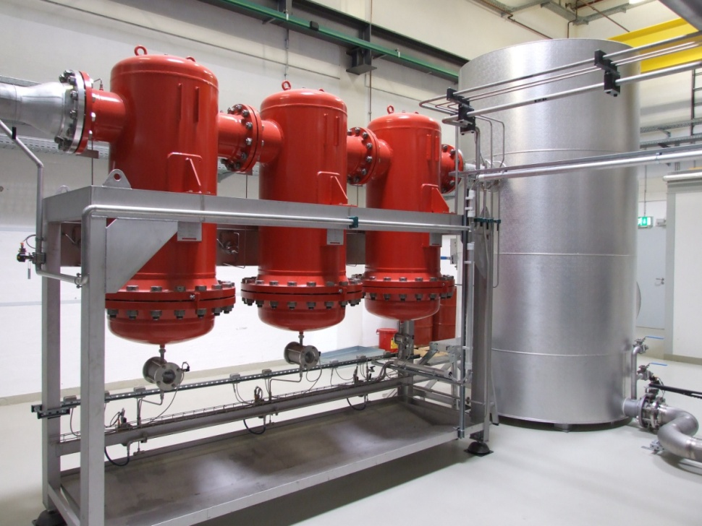
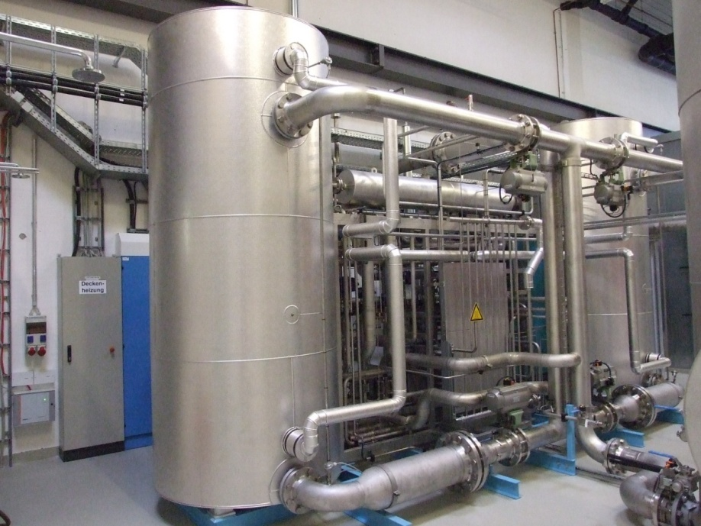
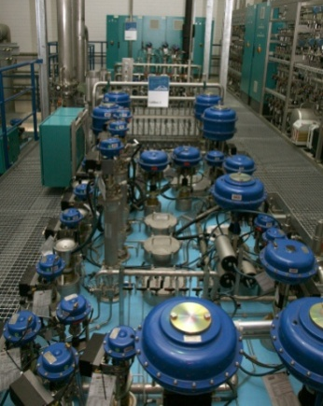
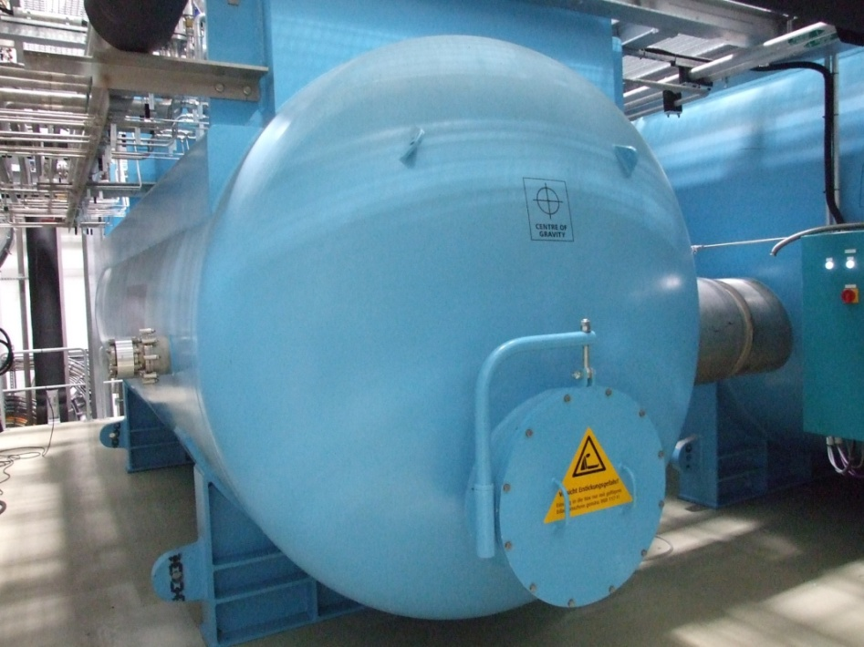
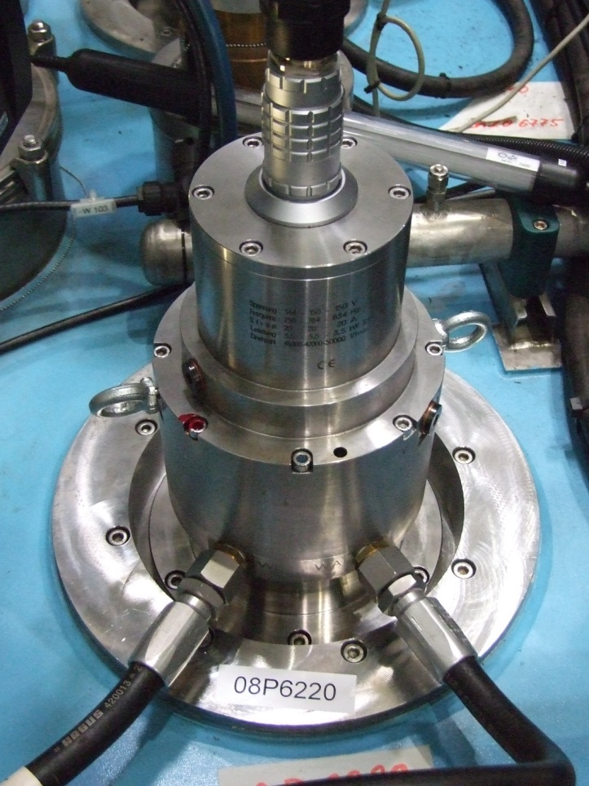
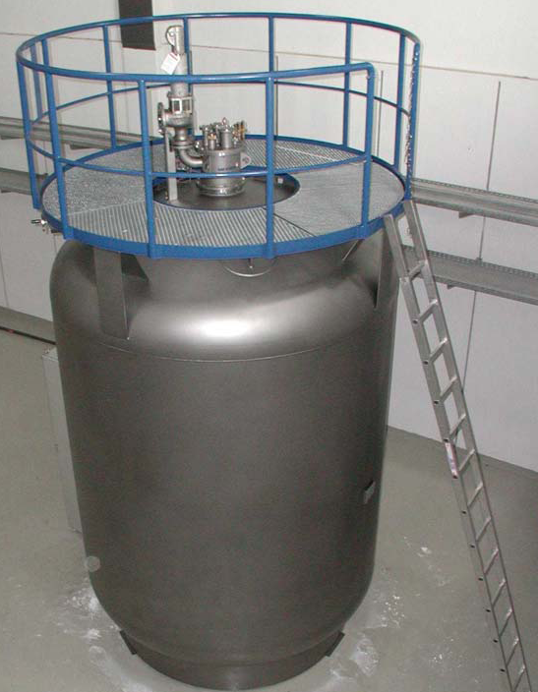
1. Introduction
Layout of cryo plant
No. | Device
7 kW | Refrigerator power at 4.5 K
2 | Screw compressors 1.6 MW electrical power
3 | Pressure levels 1.1; 3-4;11-17 bar
1 2 | Oil removal system Dryers
7 | Turbines in cold box
1 | Phase separator
2 | Sub coolers with cold compressors
4 | Cold circulators
1 | LHe - dewar
5 | Different consumers
Screw compressor
Coalescer + adsorber
dryer
Cold box
Cold box
LHe- dewar
Cold pump
Notes:
The slide gives an overview of the cryo plant.
The refrigerator has a cooling power of 7 kW at 4.5 K.
2 screw compressors are used to compress the helium from 1.1 bar to the medium pressure of 3 bar and then from 3 bar to high pressure of 14 bars.
After oil separator and gas cooler the remaining oil is taken out of the helium flow with three coalesces and a charcoal adsorber.
Two dryers with silica gel filling remove the remaining water out of the helium flow.
Seven turbines in the cold box produce the cooling power.
One phase separator and two sub atmospheric baths are located inside the sub cooler box.
4 cold circulators pump the helium trough the heat exchangers in the baths and through the cooling circuits.
The refrigerator supplies five consumers (coils, supports structures, thermal shield, current leads, cryo pumps.).

Slide 6
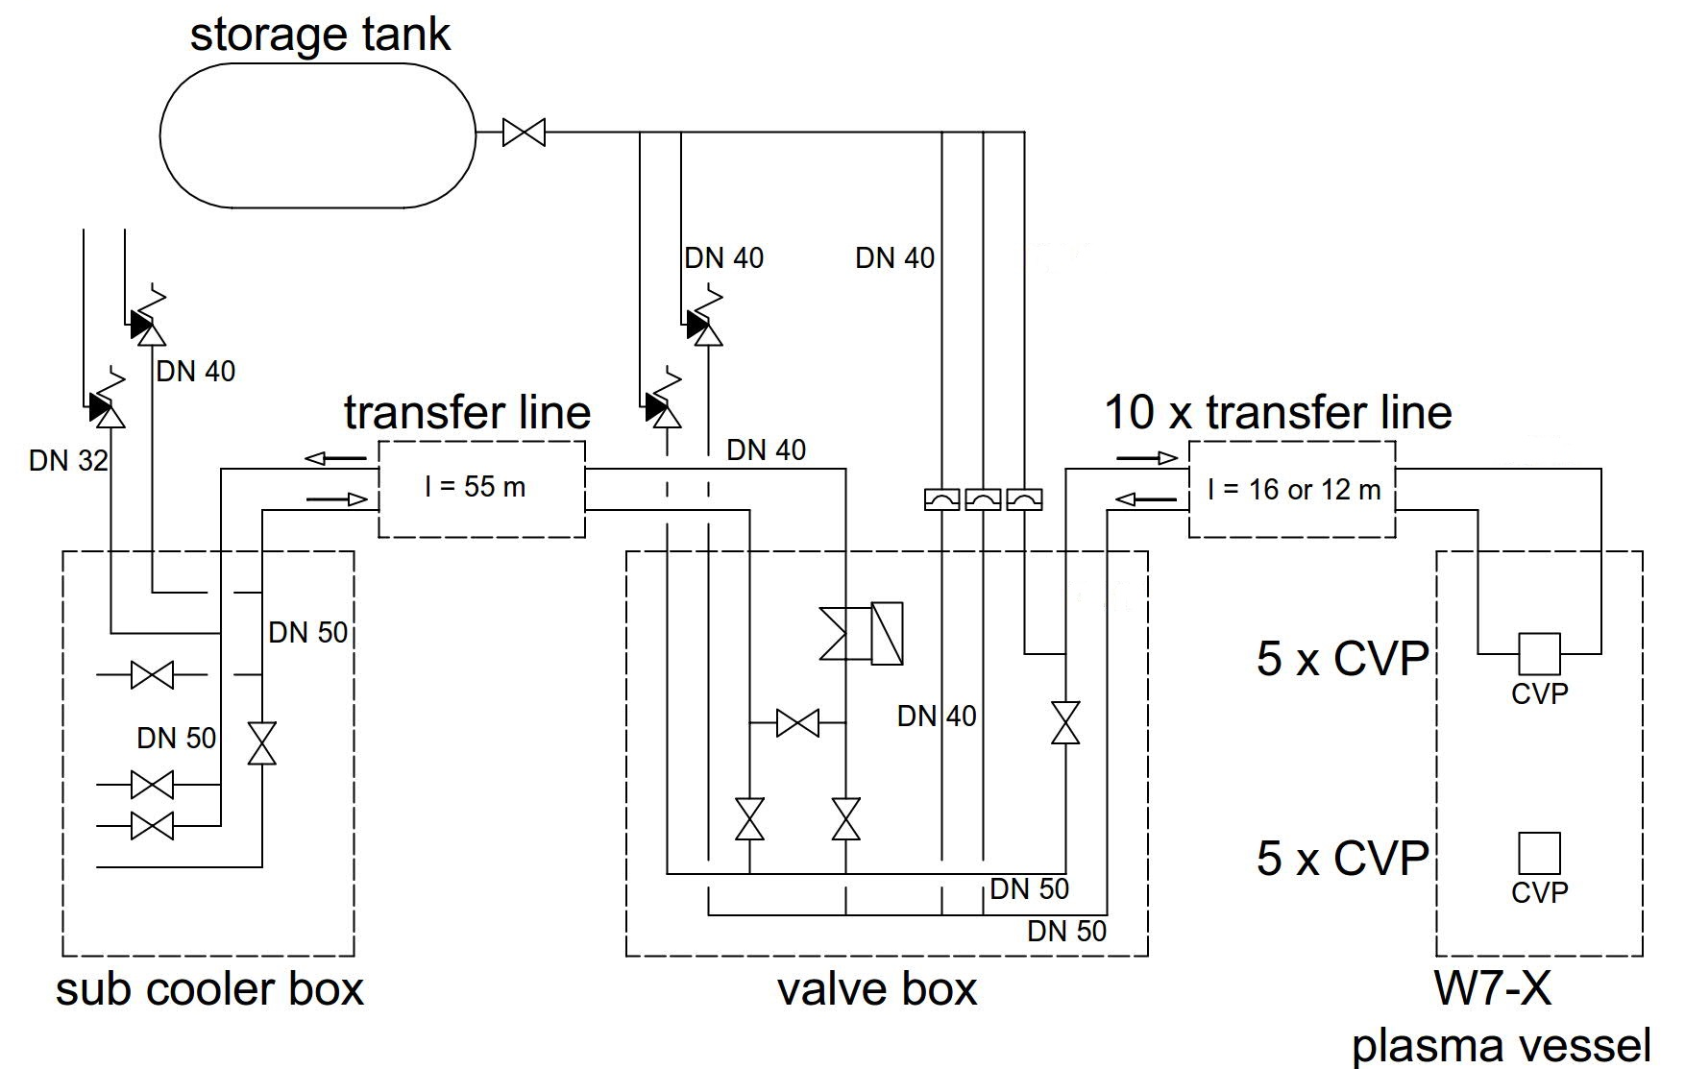
2. Layout of the cryo distribution
Conceptual layout for the helium cooling circuit
1 common flow from SCB to valve box
splitting the flow within valve box
10 short transfer lines run into plasma vessel to the 10 CVP
parallel cooling schema
almost same schema for LN2
Notes:
The conceptual layout for the helium circuit us shown in slide 5.
A common transfer lines runs from the sub cooler box to the valve box in the torus hall below the cryostat.
Inside the box, the flow is split into 10 cooling circuits.
Each circuit supplies one cryo pump.
10 short transfer lines run from the box to the cryostat interface.
From the interface, the pipes are routed through ports inside the plasma vessel to the individual CVP.
Safety valves and rupture discs are connected with a warm gas storage tank.
The schema is almost the same for the LN2-circuit.

Slide 7
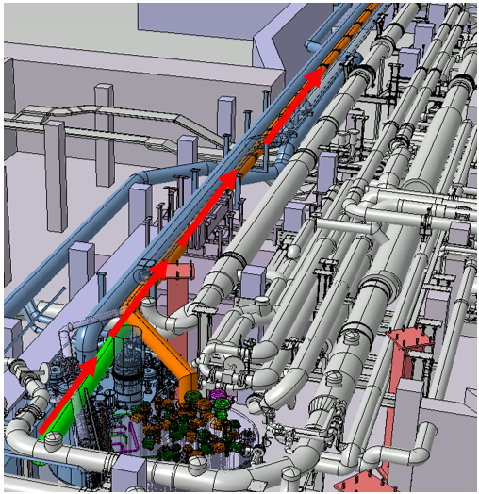
2. Layout of the cryo distribution
Common TL from SCB to valve box
Multi channel transfer line Ø323.9 mm
2 helium + 2 LN2 process pipes (Ø48 mm)
Supports made of G10
Thermal shield, actively cooled
MLI wrapped around process pipes
MLI between vacuum jacket an shield
Special mounting procedure:
Assembly starts in area of the CVB
CTL segment to be lifted up to the ceiling of the floor
Aligned and then partially stringed into the narrow pipe channel
Next segment is lifted, aligned and welded to the previous segment.
Group of segments are stringed further into the narrow pipe channel.
Process is repeated seven times
Space restriction limits the maximum length of the segments to 4.6 m.
Notes:
The next slide shows a CAD-drawing of the area below the torus with the valve box, the common transfer line plotted in orange and the surrounding piping.
The common transfer line is a multi channel transfer line with an OD of 324 mm.
Inside there are 2 helium process pipes and 2 LN2 process pipes with an OD of 48 mm each.
The pipes are fixed with supports made of glass fiber reinforced plastic.
The pipes are enclosed by an actively cooled thermal shield. Multi-layer insulation is wrapped around the process piping. There is also MLI between the vacuum jacket and the thermal shield.
A special mounting procedure is needed because of the crowded environment.
The assembly starts in area of the CVB. The TL segment is lifted up to the ceiling of the floor, is then aligned and partially stringed into the narrow pipe channel.
The next segment is lifted, aligned and welded to the previous segment.
The group of segments are stringed further into the narrow pipe channel.
The process is to be repeated seven times.
Space restriction limits the maximum length of the segments to 4.6 m.

Slide 8
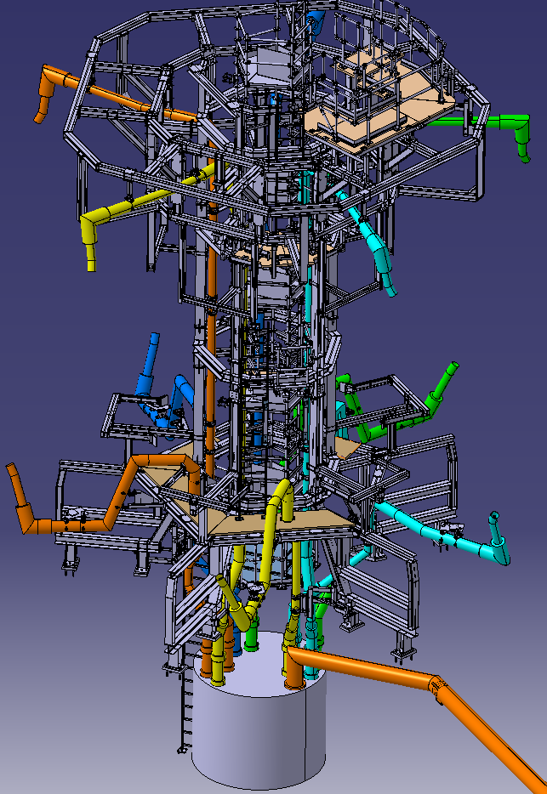
2. Layout of the cryo distribution
Short TL from valve box to port Interface
10 short TL’s run through torus center
Support structures and diagnostics need to be circumvent
Three dimensional routing required
Multi channel transfer line (same concept as CTL)
Vacuum jacket: Ø159 mm regular case, Ø219 mm at special locations only
thermal shrinkage of process pipes
Risk caused by loss of vacuum minimized
separate vacuum for each transfer line
Shrinkage of vacuum jacket when a process pipe breaks
➔ Lateral and axial bellows, flexible hoses
Notes:
10 short TL run from the VB through the center of the torus to the ports of the W7-X cryostat.
5 ports are placed at the lower side, 5 at the upper side of the cryostat.
The place in the center is already filled with support structures and diagnostics.
So the process pipes need to circumvent these components resulting in a three dimensional pipe routing.
These TL are multi-channel transfer lines as well and have the same basic design concept as common TL.
The vacuum jacket has an OD of 159 mm in the regular case. At special locations, a diameter of 219 mm is allowed to give space for lateral or radial compensators.
The thermal shrinkage of process pipes has to be considered in the design.
The risk caused by loss of vacuum in a TL needs to be minimized. Therefore, each transfer line has a separate vacuum.
In addition, the shrinkage of vacuum jacket needs to be considered in case a process pipe breaks.
Lateral and axial bellows are used to compensate the shrinkage of the TL jacket. Flexible hoses are allowed for the process pipes.

Slide 9
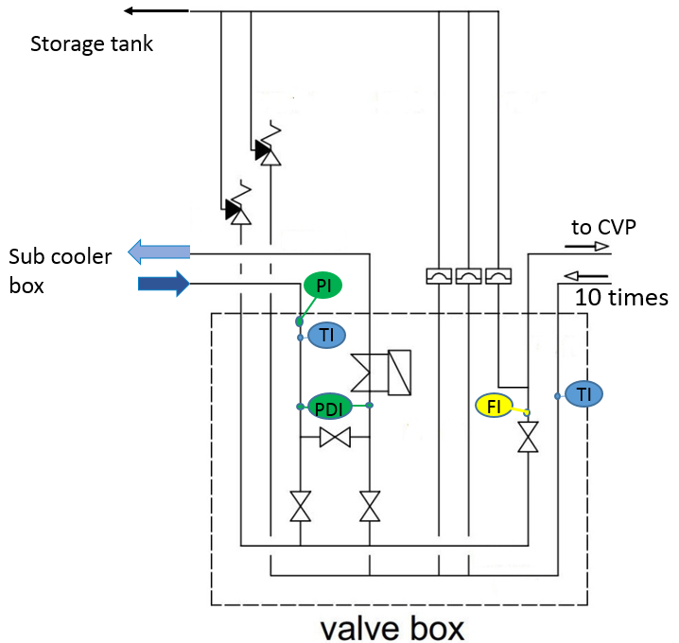
2. Layout of the cryo distribution
feed flow is distributed to 10 parallel cooling circuits
return flows are collected in return header
pressure and pressure drop between in- and outlet
1 temperature sensor in the common inlet line
10 temp. sensors in the parallel return lines
1 control valve + 1 flow measurement in each feed line
bypass between feed and return header
electrical heater inside the box
safety valve, rupture disks.
non-return flaps
nitrogen circuit is almost a copy
Valve Box
Notes:
The next silde shows the concept for the valve box.
The feed flow is distributed to 10 parallel cooling circuits.
The return flows are collected in the return header.
The pressure in the process pipe is measured at the inlet and the pressure drop is measured between in- and outlet.
1 temperature sensor is placed in the common inlet line.
10 temp. sensors are installed in the parallel return lines.
There are 1 control valve and 1 flow measurement in each feed line.
A bypass between feed and return header allows to disconnect the cryostat without stopping the flow coming from the cryo plant.
An electrical heater inside the box can simulate the heat load on the helium flow in the CP.
Safety valves and rupture disc will open and guide the flow to a warm gas storage tank in case of vacuum loss in the plasma vessel or in the vacuum jackets of the TL.
Non-return flaps in the process pipes and in the safety lines help to stabilize the flow.
The nitrogen circuit is almost a copy of the helium circuit.

Slide 10
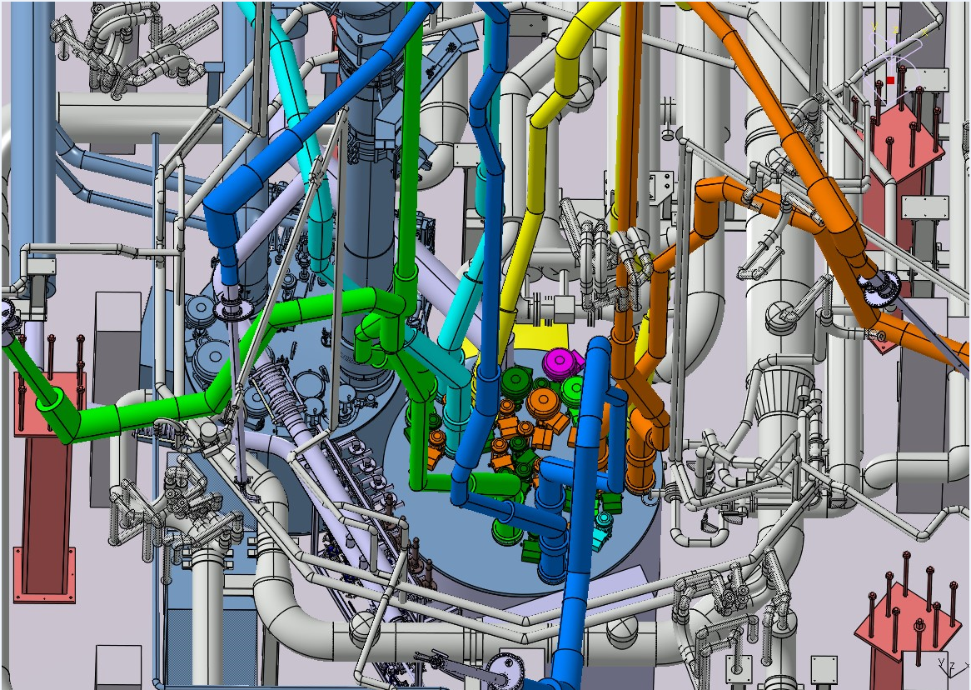
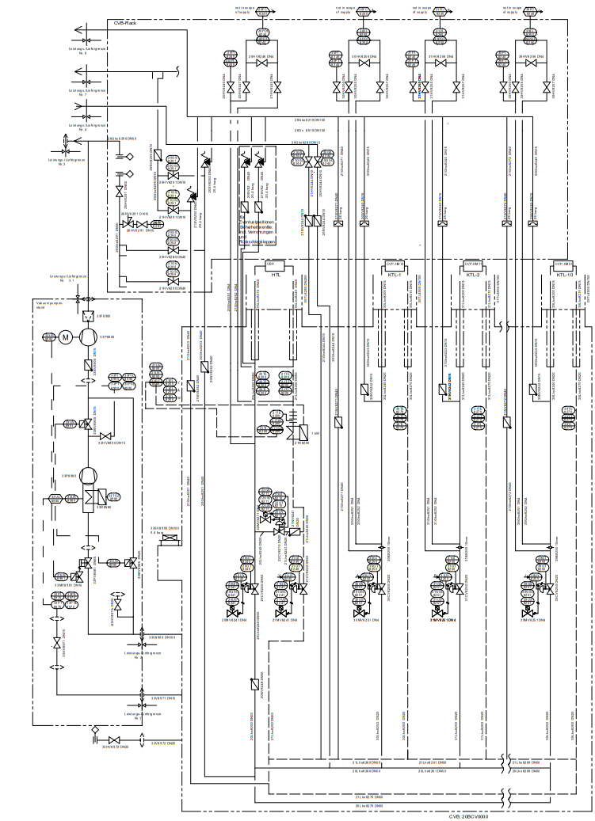
2. Layout of the cryo distribution
valve box
Notes:
The next slide shows a CAD drawing of the VB below the torus.
The VB is marked with the red circle.
TLs and actuators for the cryo valves are placed on the base plate of the box.
On the left-hand side is the valve box for the coil cooling circuits.
The P&I-Diagram for the VB is shown on the right giving more details than the
previous simplified schema.

Slide 11
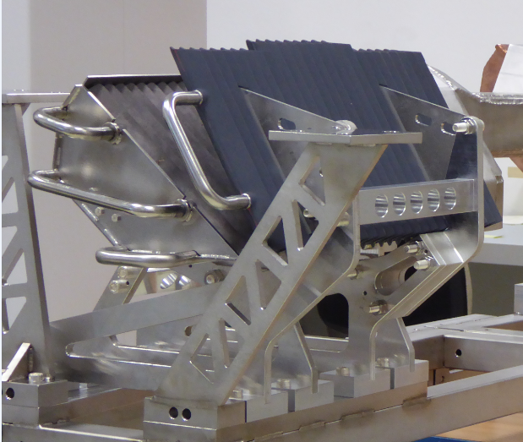
2. Layout of the cryo distribution
View on cryo vacuum pump
water baffle
Flow path to the CVP
process pipes routed through port into the plasma vessel and connected to 10 CVP’s.
process pipes Ø12x1
overall length of piping 15.8 m
cooling of panels with helium at 3.9 K, 45 W per CVP
baffle and box cooled with LN2 at 80K
600 W / 1.2 kW per CVP
parallel cooling schema (He, LN2)
LN2-baffle
gas flow
Ehrke G at al., Design and manufacturing of the Wendelstein 7-X cryo-vacuum pump, 2018 Proc. of the Symp. on Fusion Technology, September 16-21, Naxos (Italy)
Notes:
A picture of the CP is shown on the left side.
Gas that is pumped has to pass first the water cooled and then the liquid nitrogen cooled baffle.
Behind the nitrogen baffle the gas is frozen on the He-panels (mostly hydrogen).
The process pipes for the CVP cooling run through port into the plasma vessel and are connected to 10 CVP’s.
The piping has a diameter 12 mm.
The overall length of the piping is 15.8 m.
The cooling of panels is done with helium at 3.9 K. The load on a single CVP is estimated to 45 W.
The LN2-baffle and the box are cooled with LN2 at 80K
The expected heat load on the shield is 600 W in the beginning.
Later when longer plasma pulses are operated up to 30 minutes, the load will increase to 1.2 kW per CVP.
A parallel cooling schema is used for the He and LN2 circuits.

Slide 12
3. Functional requirements
Functional requirements for the transfer lines and CVB
 |  | CTL | STL | CVB | CVP
Heat load on | He line | ≤ 0.2 W/m | ≤ 0.35 W/m | ≤ 30 W (total) | ≤ 45 W
 | LN2-line | ≤ 0.5 W/m | ≤ 1.0 W/m | ≤ 150 W (total) | ≤ 600 / 1200 W
Pressure drop | He, 250 g/s | ≤ 3.2 kPa | ≤ 2.2 kPa | ≤ 2.5 kPa | ≤ 40 kPa
 | LN2, 68 g/s | ≤ 1.0 kPa | ≤ 5.0 kPa | ≤ 5.5 kPa | ≤ 100 kPa
Helium lines 165 W
10 CVP 450 W
Pressure drop limited by cold circulator 60 kPa
2-phase cooling for LN2
Return flow has a mass vapor fraction of about 90%
LN2 mass flow defined by heat load (68 g/s)
Notes:
The functional requirements for the TL and the VB are plotted for the helium circuits on the slide.
The allowed heat load on the common TL is 0.2 W/m and 0.35 W/m for the short TL.
The harder space requirements for the short TL are the reason why the higher values are allowed.
The sum of the loads for the valve box is specified with 30 W. The value for the CP is also given.
Altogether, the load on the TL + CVB are 165 W and 450 W on the CVP.
The limits for the pressure drop in the different circuits are printed below.
The cold circulator limits the maximum allowed pressure drop to 600 mbar for the helium circuits.
The corresponding numbers are printed for the nitrogen circuit.
Here as well the accepted loads for the short TL are higher than for the common TL.
The heat on the CVP mainly dominates the loads.
2-phase flow is foreseen for the cooling.
The return flow should have a vapor fraction of about 90% to avoid overheating of the gas phase.
The heat load defines the minimum mass flow rate of 68 g/s.

Slide 13
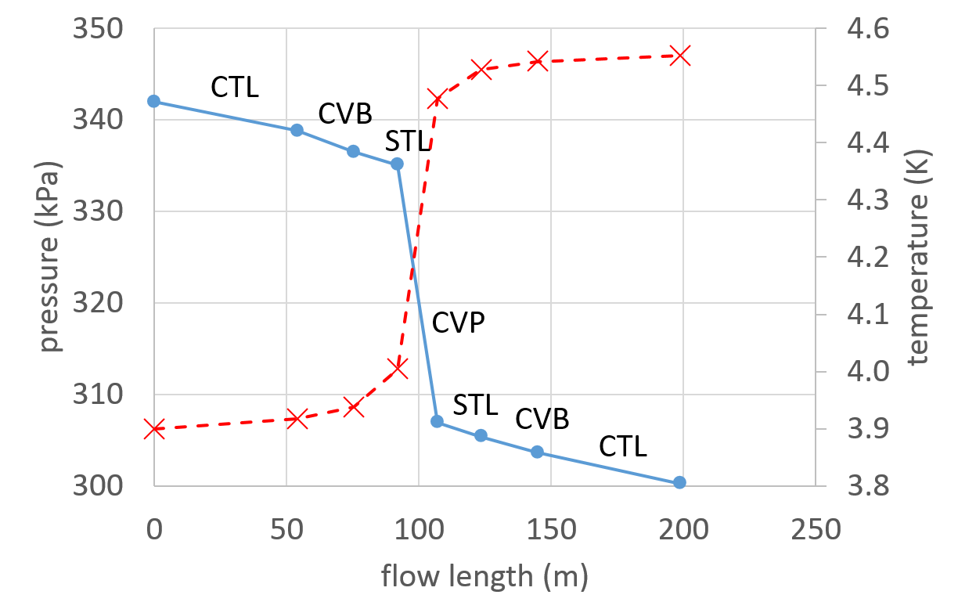
4. Results
Pressure drop and temperature rise for helium circuit
Calculated pressure along the flow path (feed + return)
Only values at inlet/outlet of components are plotted.
Steady state compressible flow calculation
Pressure drop caused by pipe friction, pipe bows, valves, and density change due to pressure drop and heat loads
CTL = common transfer line
CVB = valve box
STL = short transfer line
CVP = cryo vacuum pump
temperature
pressure
250 g/s, 515 W ➔ Δp = 42 kPa, ΔT = 0.65K
Notes:
The calculated pressure drop (blue line) and the temperature rise (red line) along the flow path are shown in the slide for the helium circuits.
The horizontal axis gives the flow path position.
The left vertical axis shows the pressure and the right axis the temperature values.
Only the values at inlet/outlet of components are plotted, therefore the straight lines.
The calculation is done for steady state condition for compressible fluids.
The pressure drop calculation takes into account pipe friction, pipe bows, losses in valves, and density change due to pressure drop and heat loads.
The mass flow rate is 250 g/s with an inlet temperature of 3.9 K. The pressure drop is 420 mbar and the temperature rise is 0.65 K.
The biggest contribution on pressure drop and heat loads causes the CVP.

Slide 14
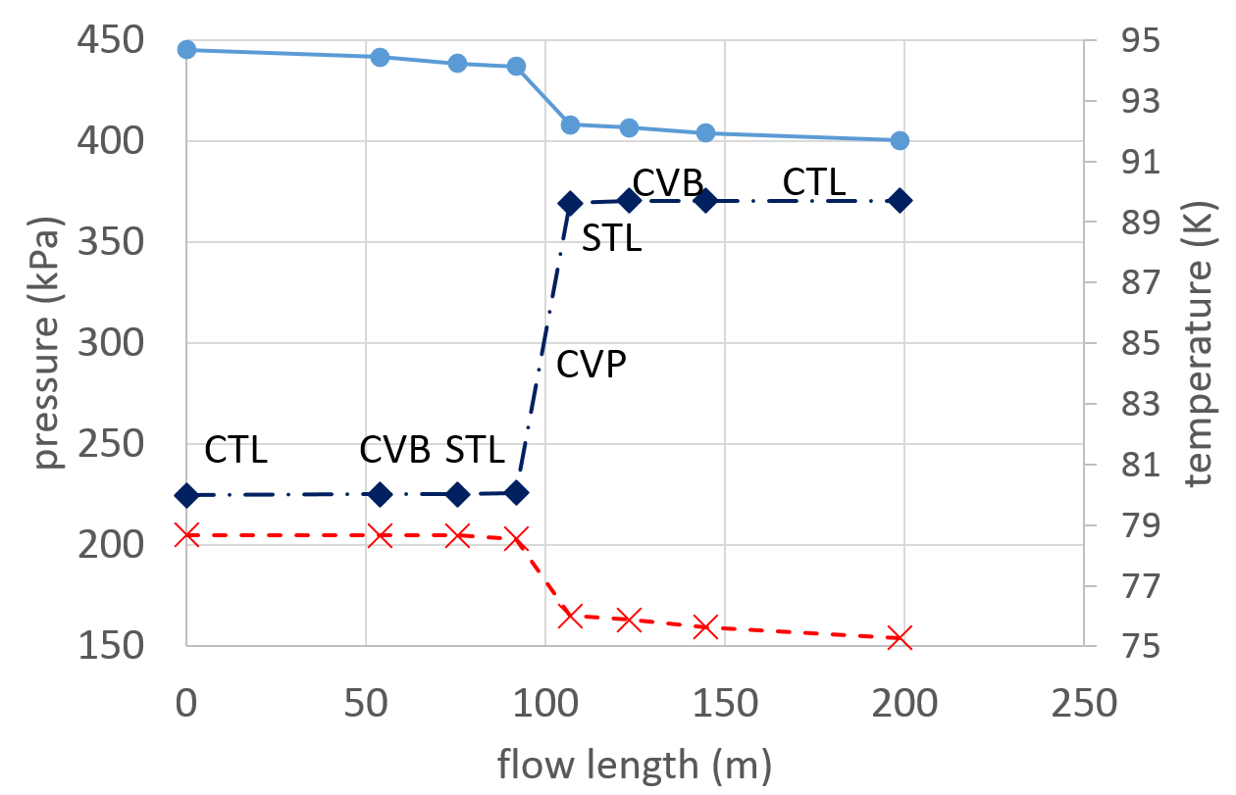
4. Results
2-phase flow, 68 g/s, 1200 W per CVP ➔ Δp = 54 kPa
Feed flow calculated as liquid, return flow as gas phase (conservative assumption)
Alternative option:
Cooling with liquid nitrogen
Cold circulator 600 g/s
➔ Δp = 50 kPa, ΔT = 10 K
CTL = common transfer line
CVB = valve box
STL = short transfer line,
CVP = cryo vacuum pump
Pressure drop and temperature rise for nitrogen circuit
Pressure, subcooled flow
temperature
Pressure, 2-phase flow
Notes:
Pressure drop and temperature rise are plotted for the nitrogen cooling circuit.
In the calculation, the feed flow is treated as liquid and the return flow as gas which is a conservative assumption.
The 2-phase cooling condition requires a mass flow rate of 68 g/s considering the heat load of 1.2 kW per CVP.
The resulting pressure drop is Δp = 540 mbar.
An alternative cooling option is the cooling with subcooled nitrogen.
A cold circulator pumps then 600 g/s of liquid through a heat exchanger that is immersed in a nitrogen bath, and then through the cooling circuits.
The temperature rises by 10 K. The return pressure should be above 4 bar to avoid 2-phase flow condition.
The pressure drop over the circuit is 500 mbar.

Slide 15
5. Summary
10 cryo vacuum pumps will be installed
Cryo distribution with multi channel transfer lines
Pipe routing for transfer line from cryo plant to cryo valve box
Pipe routing for 10 parallel lines from valve box to the CVP
Panels are cooled with 250 g/s helium flow at 3.9 K
Shield and baffle cooling with LN2 (68 g/s, 12 kW)
Notes:
After the experimental campaign in 2018, the Wendelstein 7-X stellarator will be completed with 10 actively cooled divertor units.
In addition, 10 cryo vacuum pumps (CVP) will be installed behind the divertor.
The CVP is cooled with super critical helium and liquid nitrogen.
A multi-channel transfer line connects the subcooler box of the cryo plant with the dedicated valve box in the torus hall.
10 short transfer lines supply the 10 CVP’s in a parallel cooling schema.
The helium panels are cooled with a flow of 250 g/s at 3.9 K.
Shield and baffle are cooled with liquid nitrogen with a flow of 68 g/s.
Pipe routings and pipes diameters are defined.
The conceptl fulfills the requirements.

